Slide 1





Search and Society
Reimagining Information Access for Radical Futures
Bhaskar Mitra
Principal Researcher, Microsoft Research*
@UnderdogGeek bmitra@microsoft.com
* The views expressed in this talk are my own and do not reflect that of any institutions I am affiliated with.
Notes:
It is my absolute pleasure to be here today giving this talk and I am looking forward to follow-up conversations throughout the day. Today, I want to briefly share some thoughts and reflections that are on the top of my mind on the topic of the future of information access in context of the fast-changing AI landscape. The views I will share in this talk are my own and do not reflect that of any institutions I am affiliated with.

Slide 2


Information retrieval research is undergoing transformative changes
What AI makes plausible
What the world needs
Generative AI may enable new ways in which we access information, but we are only starting to understand and grapple with their broader implications for society
Our world is facing a confluence of forces pushing us towards precarity (e.g., global conflicts, pandemics, and climate change) and we need robust access to reliable information in this critical time
What IR research should we do?
Notes:
I am an information retrieval (IR) researcher. The field of IR is currently in a period of transformative change. This is in part due to the recent emergence of generative AI and their applications in the context of online information access. In just the last couple of years or so, we have witnessed conversational search interfaces such as Bing Chat go from being aspirational to being deployed at web-scale. We also see systems like Microsoft 365 Copilot increasingly embed themselves in users’ work processes and performing information lookup on behalf of the user, in essence shifting search from being user-driven to more context-driven. These are a couple of examples of how LLMs and other generative AI approaches are changing how we access information and the priorities for IR research.
At the same time, there is another force that should be shaping information access research. Our world is experiencing rising global conflicts, pandemics, and impending climate catastrophes. Robust access to reliable information is a key ingredient to addressing many of these global challenges. In this context, the concerns for IR research are not limited to topical relevance, speed, and convenience of retrieving information artefacts but also how IR systems impact knowledge production, health education, and social change in our communities.
As researchers and practitioners, we need to recognize that there is a growing tension between IR research being guided by “what AI makes plausible” vs. “what the world needs”.

Slide 3

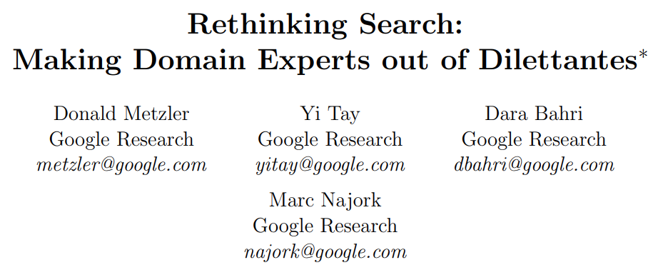
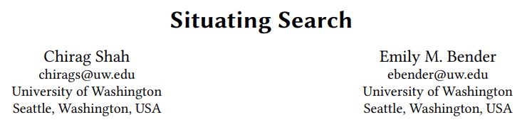
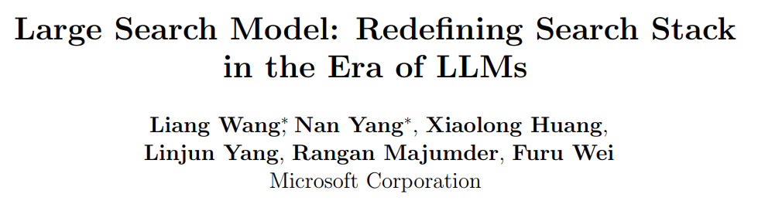
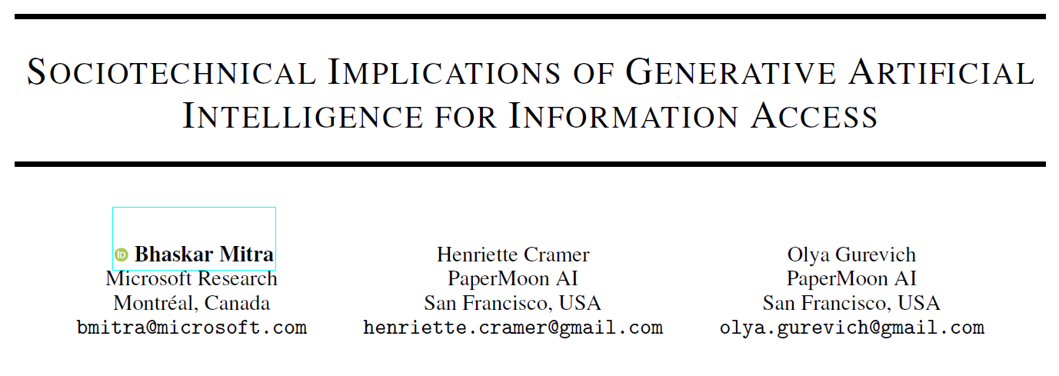



Generative AI for information access The tale of two research perspectives
Helps realize new information access modalities; reimagines the information retrieval stack; predicts relevance as well as anyone besides the original searcher
Disrupts information ecosystems; increases misinformation; concentrates power; reproduces historical marginalizations; accelerates climate change
Notes:
What we are observing are these split perspectives on the promise of generative AI for information access.
On one hand, these technologies may help realize new modalities for information access and help reimagine the whole search stack. These technologies are also demonstrating dramatic improvements on some of the core age-old challenges in IR, such as relevance prediction. For example, last year, we found that LLMs can estimate the actual searcher’s preference for documents, given their query, better than several populations of human relevance assessors. LLMs can now estimate relevance at least comparably if not more accurately than the human relevance assessments that have guided decades of IR research. This sort of marks a watershed moment for the field.
On the other hand, there are reasons to worry about how generative AI may disrupt our online information ecosystem, act as misinformation superspreaders, concentrate power, and reproduce historical marginalization. And of course, all of this along with a heavy price tag of accelerating anthropogenic climate change.
So, how do we reconcile these two sides? Is it effective in the long-term to have most of the AI, ML, NLP, and IR communities chasing new model capabilities while a subset of the community is relegated to identifying risks and mitigation strategies? To us in this room, as researchers, practitioners, legal experts, and members of the civil society, does it feel like we are addressing these concerns effectively and adequately? While I acknowledge that there is a wide range of opinions on this, I am going to hazard a guess that most of you in this audience think we have a long way to go to ensure that these technologies benefit, not harm, society as a whole.

Slide 4
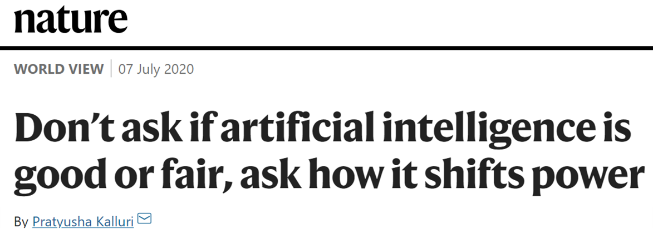
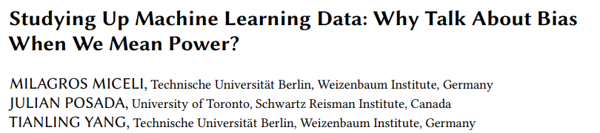
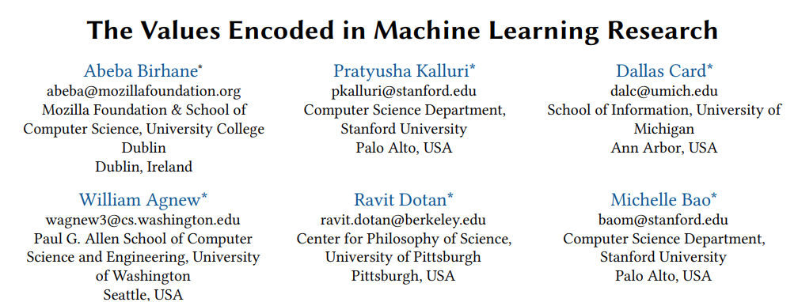
Re-interrogating AI fairness and ethics frames
If you work in AI ethics or any related area, does it feel like you are stuck in never-ending loops of enumerating the risks of technologies that are constantly emerging ?
Are we often mis-framing how AI impacts power and justice as concerns of algorithmic fairness and bias that detract from underlying sociotechnical issues?
Does the “responsible AI” frame itself center on the presupposition that AI can be made responsible and that it is the technology, not the power concentration by those building / wielding it, that should be challenged?
Notes:
I want to provoke certain conversations in this room today. Both on the sociotechnical implications of generative AI for information access as well as on how we approach and frame these questions as a community.
To those working in responsible AI, AI ethics, AI & Society, FAccT, or any related fields: Does it feel like you are constantly stuck enumerating the risks of one emerging technology, and before you have barely scratched that surface something else new and shiny comes around and now you are enumerating the risks of that, and before long you are interrupted again by an even newer shinier thing that you must shift all your focus to, and the never-ending cycle continues? Are many of the algorithmic fairness and bias problems that we are concerned with in fact mis-framings that detract from underlying concerns of how these technologies shift power and wealth and codify structures of injustice? Should we in this room, while attending an event called “Responsible AI” take a moment to question if that frame itself presupposes that the current incarnation of these technologies can be made responsible? Should we recognize that how we are developing AI technologies today at least in part mirrors large scale extractive practices that concentrate wealth and power? Can we interrogate towards what end we are building these AI technologies and radically reimagine how we build them?
We should broaden our lens from narrow focus on AI fairness and bias to broader sociotechnical considerations for these systems that emphasize their systemic consequences and socially grounded risks. I believe we must also go further and critically reflect on how we do AI fairness and ethics research, the power and incentive structures that guide such research, who is allowed to conduct such research, and whose critical perspectives in the community are overlooked. This is the focus of my talk today.

Slide 5

How should we think about the sociotechnical implications of generative AI for information access?
Notes:
Let’s talk first about the sociotechnical implications of generative AI for information access. How should we frame this question and organize the different relevant considerations?

Slide 6
Consequences-Mechanisms-Risks (CMR) framework
Consequences
Mechanisms
Risks
Consequences motivate viewing the changes introduced by the technology through a systemic lens
Mechanisms contribute to consequences and risks; represent sites for actionable mitigation
Risks ground any investigation or mitigation to actual potential harms on people
Identified consequences, mechanisms, and risks can be mapped to each other
High-level implications of moral import
System behaviors and process of development
Harms that may materialize for people and groups
Gausen, Mitra, & Lindley. A Framework for Exploring the Consequences of AI-Mediated Enterprise Knowledge Access and Identifying Risks to Workers. In Proc. FAccT, 2024.
Notes:
I would like to quickly introduce a framework that we will be presenting at the FAccT conference next week. The Consequences-Mechanisms-Risks framework provides a structure for conceptualizing and organizing implications of new technologies and applications. The goal of this framework is to support designers and developers of AI (and in general any computational) systems to identify and understand (i) the systemic consequences of developing and deploying the technology in question in the real world, (ii) the mechanisms introduced by said technology responsible for these consequences, and (iii) the corresponding risks to relevant stakeholders. The framework intentionally explicates the higher-level consequences to motivate viewing the challenges through a more systemic lens. The mechanisms, in turn, focus on more low-level system behaviors and aspects of the technology development process that contribute to the consequences and risks, and therefore represent sites for more actionable mitigation. Identified consequences, mechanisms, and risks are mapped to each other in this framework. However, how you map and organize these concepts depends on the specific context and goals of the exercise.

Slide 7
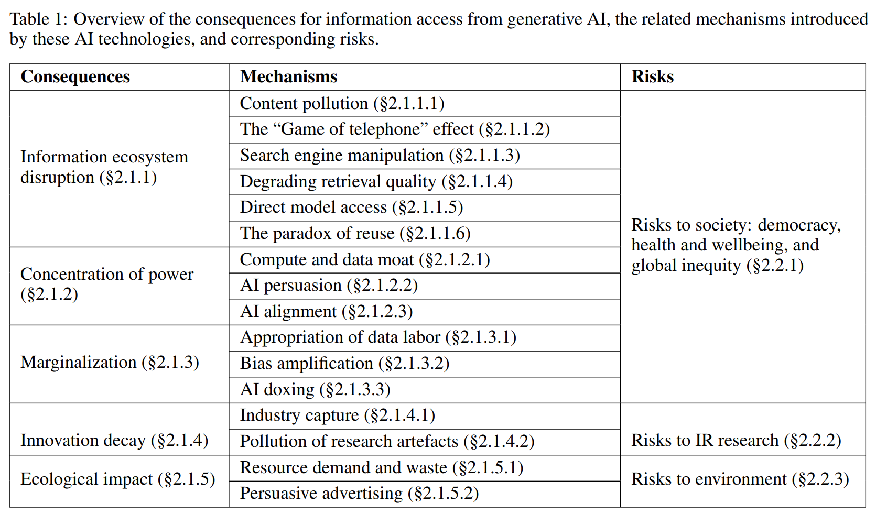
Sociotechnical implications of generative AI for information access
Mitra, Cramer, & Gurevich. Sociotechnical implications of generative artificial intelligence for information access. Preprint of chapter for an upcoming edited book, 2024.
Notes:
We recently put out a preprint of a chapter for a forthcoming book on generative information retrieval co-edited by Chirag Shah and Ryen White, where we use this CMR framework to organize some of the sociotechnical implications of generative AI for information access that we identified based on a survey of existing literature. We identify five systemic consequences and several mechanisms corresponding to each of them and consider three broad areas of risks (i) to society, (ii) to IR research, and (iii) to the environment.

Slide 8
Consequences of generative AI for information access
Information ecosystem disruption
Significantly changing how different actors and stakeholders in the online information ecosystem operate on their own and how they relate to each other
Concentration of power
Worsening inequities in how power and control are distributed within our society and different communities
Marginalization
Relegating certain individuals and groups to the margins of society and corresponding discrimination
Innovation decay
Ecological impact
Constraining scientific explorations to specific narrow directions while throttling progress in other areas of information access research
Worsening anthropogenic climate change
Mitra, Cramer, & Gurevich. Sociotechnical implications of generative artificial intelligence for information access. Preprint of chapter for an upcoming edited book, 2024.
Notes:
The five consequences we identify are: (i) Information ecosystem disruption, (ii) concentration of power, (iii) marginalization, (iv) innovation decay, and (v) ecological impact. We consider how generative AI may potentially disrupt how content is produced, consumed, monetized, and manipulated towards specific ends and how different actors and stakeholders operate and related with each other. We deliberate on how these technologies and systems shift and concentrate power while further marginalizing those at the periphery. We consider the impact on academic research and innovation itself as well as the ecological costs of our current AI technology trends.

Slide 9
Mechanisms of information ecosystem disruption
Other mechanisms
Content pollution. Enabling low-cost generation of derivative low-quality content at unprecedented scale that pollute the web.
The “Game of telephone” effect. LLMs inserted between users and search results shifts the responsibility of information inspection and interpretation to the LLM.
Search engine manipulation. E.g., prompt injection attacks.
Degrading retrieval quality. E.g., Minimizing click feedback signals.
Direct model access. Open access models pose challenges for content moderation.
The paradox of reuse
Websites like Wikipedia and StackExchange power online information access platforms, which in turn reduce the need to visit those websites.
Examples. LLMs training on content from these websites that they later regurgitate without attribution. LLM-powered conversational search systems deemphasize source websites reducing the clickthrough relative to the classic ten-blue-links interface.
Mitra, Cramer, & Gurevich. Sociotechnical implications of generative artificial intelligence for information access. Preprint of chapter for an upcoming edited book, 2024.
Notes:
One mechanism by which generative AI may disrupt our online information ecosystem is what Dario Taraborelli calls the “paradox of reuse”. Content producers and online platforms share a critical inter-dependant relationship. Websites such as Wikipedia, StackExchange, and Reddit make services like web search significantly more useful to their users. In return, these platforms have historically sent traffic back to these websites that contribute to their increased readership, subscription, and monetization. However, when these platforms stop directing traffic back to these websites the relationship becomes less symbiotic. When LLMs train on content from websites they later regurgitate without attribution they are intensifying this phenomenon. When LLM-powered conversational search interfaces deemphasize hyperlinks to source websites they reduce clickthroughs relative to the classic ten-blue-links, again having a similar effect. There is evidence that support that this phenomenon is already happening at scale and is jeopardizing the “grand bargain at the heart of the web” between these platforms and the content producers.
Other mechanisms include enabling low-cost generation of derivative low-quality content at unprecedented scale that pollute our web. Another mechanism arises when we insert LLMs in between the user and the search results, for example in chat-based search interfaces, shifting the responsibility to inspect and interpret the retrieved information to the LLM and potentially prompting a “game of telephone” or “noisy communication” effect. Btw, I prefer this framing over the more popular but misanthropomorphizing framing of “hallucinations” for several reasons that I won’t go into right now. Generative AI may also make our search systems more vulnerable to manipulation, such as via prompt injection attacks. They may even directly impact the underlying retrieval system quality negatively over time. For example, by deemphasizing the links to source websites on the chat interface it may minimize the quality and quantity of user click signals that are available for the underlying search system to learn from in the future. Lastly, open access models also pose challenges for content moderation.

Slide 10
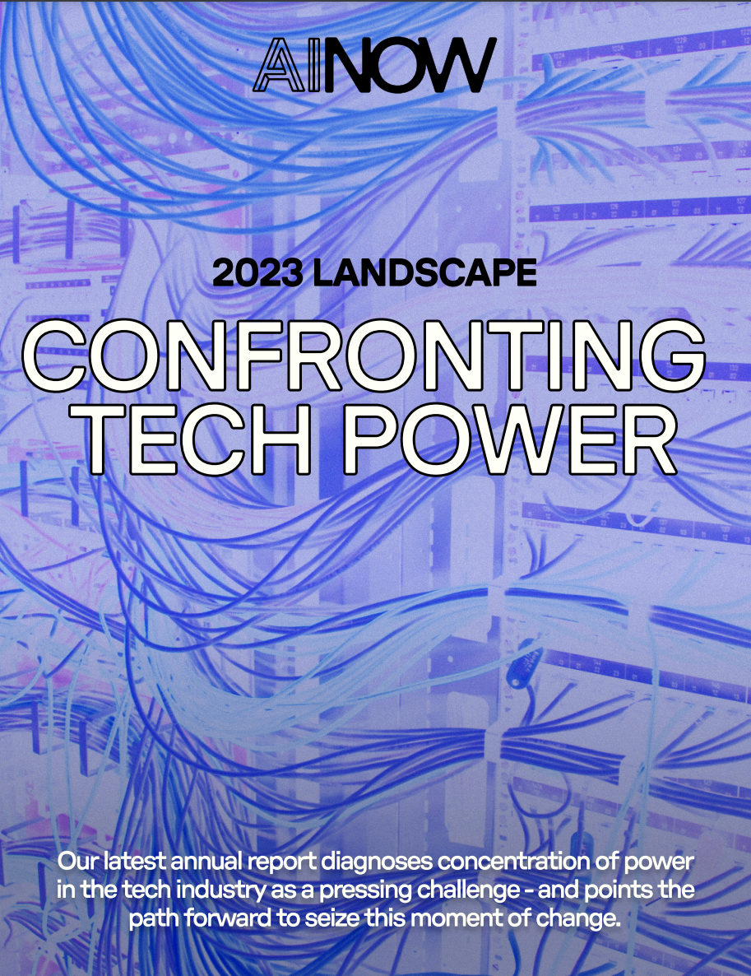
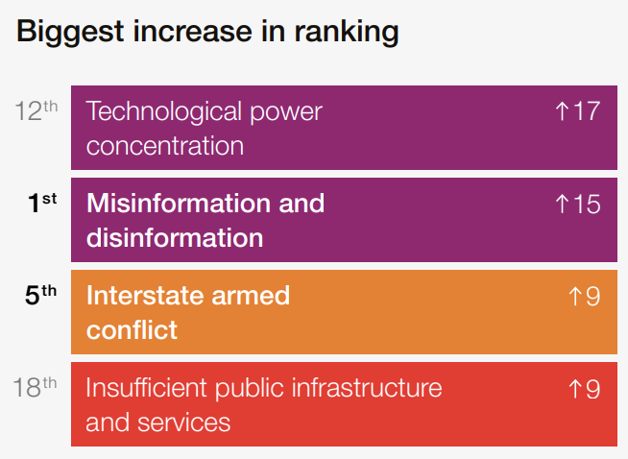

On technological power concentration
Annual change in global risk perceptions over the short term (2 years)
Mitra, Cramer, & Gurevich. Sociotechnical implications of generative artificial intelligence for information access. Preprint of chapter for an upcoming edited book, 2024.
Notes:
Any discussion about the social consequences of technology should include considerations of how the technology, and the general narratives about the technology, shifts power and codifies structures of hierarchy and control. A report from the research institute AI Now asserts the concentration of economic and political power in the hands of the tech industry as the core challenge posed by AI. They note that not just the technologies but the narratives (both the hype and the fear-mongering) around them questionably bolsters claims of “foundational” advancements. The 2024 edition of the World Economic Forum’s Global Risks Report lists “technological power concentration” as the 12th top global risk for the coming decade and as the biggest upward mover in their annual ranking of global risks compared to the previous year.

Slide 11
Mechanisms of concentration of power
Compute and data moat. Only a handful of (typically private sector) institutions own and control the compute and data resources for training and deployment of generative AI models. Availability of “open access” models don’t fundamentally challenge the predominant vision of what AI looks like today, which would require dismantling the data and compute moat itself and turning them into public infrastructure.
AI persuasion. A process by which AI systems alter the beliefs of their users. E.g., application of LLMs for hyper-personalized hyper-persuasive ads.
AI alignment. Approaches such as reinforcement learning from human feedback (RLHF) presupposes some notions of desirable values to be determined and enforced by platform owners.
Mitra, Cramer, & Gurevich. Sociotechnical implications of generative artificial intelligence for information access. Preprint of chapter for an upcoming edited book, 2024.
Notes:
In this context, let’s talk about three potential mechanisms.
First, the development of generative AI is heavily reliant on the availability of large swaths of training data and largescale computing power for training and deployment. Only a handful of institutions, largely in the private sector, own and control these necessary resources giving them inordinate power to shape what AI looks like and to what end they are designed and optimized for. Increased access to these models has sometimes been touted as potential paths to mitigation but even “fully open” models that allow you to download their learned parameters do little to challenge the predominant vision of the day of what AI should look like. That would require dismantling the data and compute moat itself and turning them into public infrastructure.
Second, there is also an emerging recognition of the dangers of AI persuasion. There is research that shows that people are more likely to consume information that opposes their own personal views and beliefs when the latter employs language similar to their own political leaning. Now consider the combination of the treasure trove of users’ private preferences and behavioral data that online platforms have been collecting and the capabilities of LLMs to produce persuasive language to create terrifyingly effective tools for mass behavioral manipulation through ads and other forms of algorithmic nudging. Note, you don’t even need platform owners to maliciously want to manipulate public opinion in this case, simply optimizing for user engagement and ad revenue may encourage these models to produce persuasive rage-baiting language.
Our third mechanism originates from a problem disguising itself as a solution. Approaches such as reinforcement learning from human feedback (or RLHF) have come into vogue to “align” model outputs with “human values”. However, this approach presupposes some notions of desirable values and puts the burden of determining and enforcing them on the shoulders of platform owners, without any democratic and civil society oversight, further concentrating power to these platforms.

Slide 12
Mechanisms of marginalization
Appropriation of data labor
Includes the uncompensated appropriation of works by writers, authors, programmers, and peer production communities like Wikipedia and under-compensated crowdwork for data labeling that have been instrumental in the development of these technologies.
AI for me, data labor for thee. AI data labor dynamics reinforces structures of racial capitalism and coloniality, employs global labor exploitation and extractive practices, and reinforces the global north and south divide.
Other mechanisms
Bias amplification. AI models reproduce and amplify harmful biases and stereotypes from their training datasets leading to allocative and representational harms.
AI doxing. AI models may leak private information about people present in their training data or be employed to predict people’s sensitive information based on what is known about them publicly.
Mitra, Cramer, & Gurevich. Sociotechnical implications of generative artificial intelligence for information access. Preprint of chapter for an upcoming edited book, 2024.
Notes:
AI technologies, both in their process of development and deployment, may marginalize individuals or groups by diminishing their value, power, and well-being. This may be in the context of data labor defined as “activities that produce digital records useful for capital generation”. Appropriation of data labor includes both (i) the uncompensated appropriation of works by writers, authors, programmers, and peer production communities like Wikipedia, and (ii) under-compensated crowdwork for data labeling that have been instrumental in the development of these technologies. These dynamics mirror and reinforce historical dimensions of racial capitalism and coloniality and global labor exploitation and extractive practices that may further amplify the global north and south divide. That is, while the global north accrues the benefits of AI, the global south is relegated to the role of producing data labor.
The other ways in which the application of generative AI in the context of information access may cause marginalization include amplification of harmful biases and stereotypes from training data and leaking people’s private information.

Slide 13
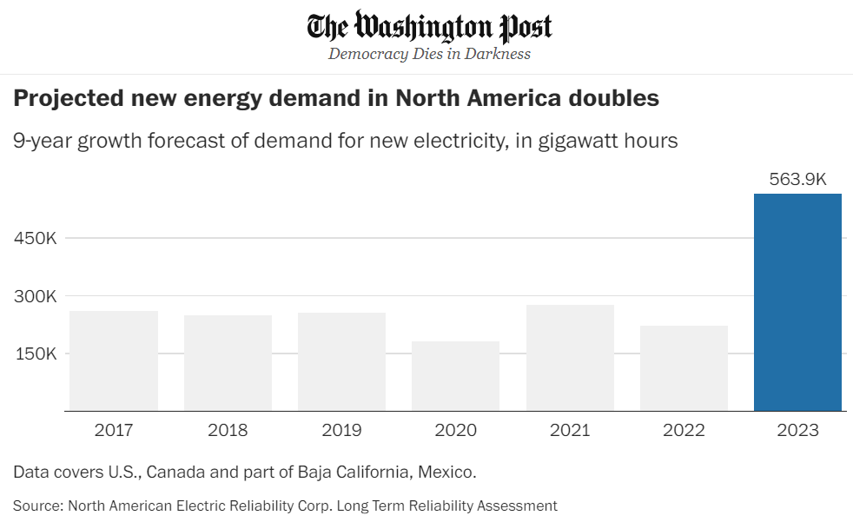
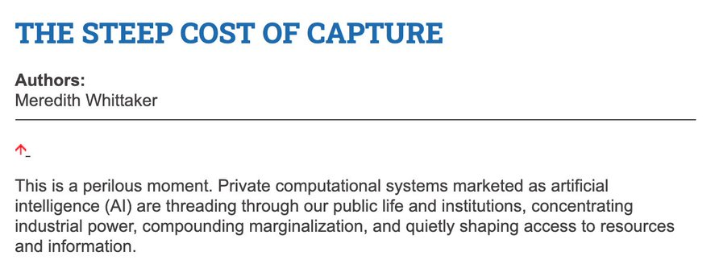
Mechanisms of…
Innovation decay
Ecological impact
Industry capture. Subjugates scientific exploration to profit-driven goals and dissuade investments in research not immediately monetizable or which challenges the status quo.
Pollution of research artefacts. Misapplications of LLMs in scholarly publications and reviewing may negatively impact IR scholarship.
Resource demand and waste. Increasing demand for electricity and water, and electronic wastes.
Persuasive advertising. Could supercharge climate change disinformation and promote environmentally unfriendly business models like fast-fashion.
Mitra, Cramer, & Gurevich. Sociotechnical implications of generative artificial intelligence for information access. Preprint of chapter for an upcoming edited book, 2024.
Notes:
Generative AI may also directly impact IR research through industry capture of academic research agendas and starve out investments in other socially important research areas that do not fit within the predominant narratives about AI today. Misapplications of LLMs for authoring papers and reviewing may also negatively impact IR scholarship.
Lastly, the ecological cost of deep learning models has been a subject of much concern and debate in the AI community. By some estimates, the computing power being utilized for deep learning research has been doubling every 3.4 months since 2012. In the US, data centers consumed more than 4% of their total national electricity in 2022, and that number is projected to grow to 6% by 2026. Another study estimates that by 2040 Information and Communications Technology industry on the whole alone would account for 14% of global emissions. By 2027, global AI demand may be responsible for withdrawal of 1.1 − 1.7 trillion gallons of fresh water annually. Serious concern also revolve around the rising levels of electronic wastes. Even as we make progress in reducing the ecological cost of training and deploying individual models, those gains may end up being redirected to develop even larger models and their even wider deployment worsening the overall ecological impact.

Slide 14
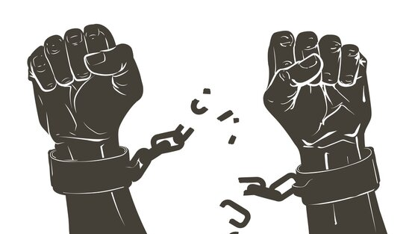
Beyond harm mitigations: Information access for our collective emancipatory futures
Notes:
We have so far talked about potential dangers of generative AI in the context of information access. Let’s take a moment now to circle back to a question I alluded to at the very beginning of this talk: What does society need from IR research and what would information access research agenda look like if we center on societal needs and not technology trends?

Slide 15

Sociotechnical imaginaries
“Visions of desirable futures, animated by shared understandings of forms of social life and social order attainable through, and supportive of, advances in science and technology”
~Jasanoff and Kim (2015)
Whose sociotechnical imaginaries are granted normative status and what myriad of radically alternative futures are we overlooking?
How does increasing dominance of established for-profit platforms over academic research influences and/or homogenizes the kinds of IR systems we build?
What would information access systems look like if designed for futures informed by feminist, queer, decolonial, anti-racist, anti-casteist, and abolitionist thoughts?
Mitra. Search and Society: Reimagining Information Access for Radical Futures. Preprint, 2024.
Notes:
A salient question that is often ignored in these conversations is what futures are we building towards for our society and what role do we envision information access technologies will play towards those transformations? We need to talk about our sociotechnical imaginaries and our theories of change. Sociotechnical imaginaries, simply put, are our visions of desirable sociotechnical futures. Correspondingly, theories of change articulate how our work and actions should take us closer towards those goals. These diverse, and often diverging, perspectives that guide the community and our own research frequently remain implicit and unstated. Whether it is the IR or the NLP or the AI community, we should critically reflect on the goals and motivations that guide our research and system development. For example, whose sociotechnical imaginaries are granted normative status and what myriads of radically alternative futures are we overlooking? How does increasing dominance of established for-profit platforms over academic research influences and/or homogenizes the kinds of IR systems we build? What would IR systems look like if designed for futures informed by feminist, queer, decolonial, anti-racist, anti-casteist, and abolitionist thoughts, and if the focus of IR and AI research was to dismantle colonial cisheteropatriarchal capitalist structures and not to prop them up? Shifting the frame from “how can current systems be less harmful” to “what social changes we want to affect and what systems should we build and how should we build them to make progress towards those goals” can guide us in different research directions and reveal new guiding strategies.

Slide 16
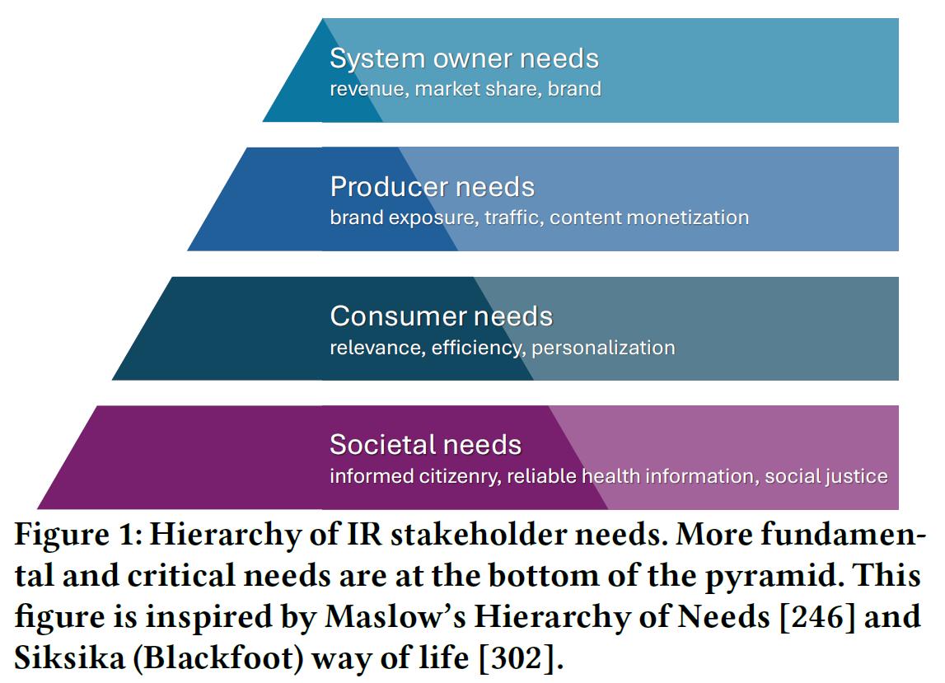
Recommendations for re-centering IR on societal needs
Explicitly articulate a hierarchy of stakeholder needs that places societal needs as the most critical concern for IR research and development
Dismantle the artificial separation between fairness and ethics research in IR and the rest of IR research; Move away from reactionary mitigation strategies for emerging technologies to proactively design IR systems for social good
Develop sociotechnical imaginaries based on prefigurative politics and theories of change
Mitra. Search and Society: Reimagining Information Access for Radical Futures. Preprint, 2024.
Notes:
IR research is guided by the needs of different stakeholders. Historically, IR has placed a strong emphasis on the needs of the user or consumer such as relevance, personalization, and faster response times. A focus on the needs of the system owners—such as revenue, market share, and brand—and those of the content publishers—for example, traffic, monetization, and exposure—have also been salient in driving significant real-world IR system design and deployment decisions. Societal concerns, on the other hand, in both IR research and industry settings have commonly been framed through narrower lenses of harm mitigation, such as “how do we make the IR system fairer?” and “how do we reduce misinformation in search results?”, without explicitly reflecting on how these systems should contribute to knowledge production, public education, and social justice. I believe there is value in explicitly articulating a hierarchy of stakeholder needs that place societal needs as the most critical and fundamental concern in IR system design and deployment, followed by (in order) the needs of the consumer, producers, and finally that of the system owners.
We should also dismantle the artificial separation between the research on fairness and ethics in IR and the rest of IR research. Societal needs cannot just be the concern of a small subset of our research and technology communities, these concerns should be central to all IR research. Instead of adopting a reactionary strategy of trying to mitigate potential social harms from emerging technologies, the community as a whole should engage in dialogs on societal good and aim to proactively set an IR research agenda for the kinds of systems we _should_ build centering on those grounded needs. Ultimately, research that attempts to affect sociotechnical change should not just transform the technology, but also every researcher and practitioner, and both are necessary for progress.
It is by intentionally centering societal needs and by engaging everyone in our communities in conversations on these topics that we can develop and explicate our sociotechnical imaginaries and our theories of change.

Slide 17
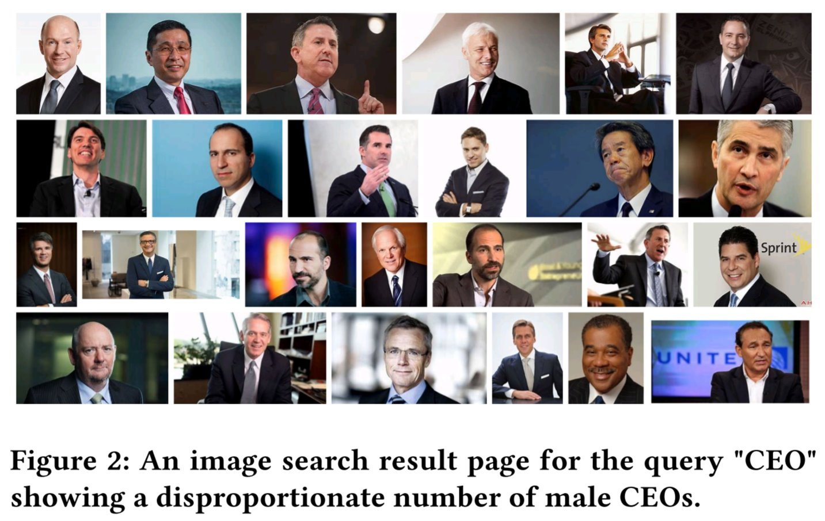


Reimagining IR through the lens of prefigurative politics
Instead of trying to algorithmically fix under-representation of women and people of color in image search results for occupational roles, can we reclaim that digital space as a site of resistance and emancipatory pedagogy by allowing feminist, queer, and anti-racist scholars, activists, and artists to create experiences that teach the history of these movements and struggles?
Can we translate Freire’s emancipatory pedagogy to strategies for anti-oppressive information access? Can search result pages support dialogical interactions between searchers that leads to knowledge production and better digital literacy?
Can emancipatory and anti-capitalist perspectives motivate us to reimagine search and recommender systems as decentralized and federated?
Mitra. Search and Society: Reimagining Information Access for Radical Futures. Preprint, 2024.
Notes:
When we shift the frame of Responsible AI or IR away from the narrow lens of harm mitigation and towards centering our desired social change, we may discover different paths forward. For example, from a decolonial IR lens, it may force fairness research to abandon the search for “universal” approaches to measuring and optimizing for fairness and shift focus to co-develop relevant local intervention strategies with local legal scholars in recognition of significant differences in legal treatment of topics such as affirmative action across geographies. Or, through feminist, queer, and anti-racist IR lens, we may decide that, say, instead of trying to algorithmically fix under-representation of women and people of color in image search results for occupational roles, we could reclaim that digital space as a site of resistance and emancipatory pedagogy by allowing feminist, queer, and anti-racist scholars, activists, and artists to create experiences that teach the history of these movements and struggles. Emancipatory and anti-capitalist perspectives may also motivate us to reimagine search and recommender systems as decentralized and federated. Or it may encourage us to think about dialogical search interfaces that enable conversations between people for knowledge production and consensus building, not between people and the system as is the focus of conversational IR. These are but few examples that I am intentionally cherry-picking to motivate what such a shift may encompass if we start from explicit sociotechnical futures and then work out what it would take to get us there, rather than starting from emerging technologies and asking how they can be made socially useful, or less harmful. This change in mindset may also encourage us to think critically about the role of organizing and movement building in socially focused IR research.

Slide 18
Who gets to participate?
This is a call for collective struggle of solidarity with social scientists, legal scholars, critical theorists, activists, and artists; not for technosolutionism.
To challenge the homogeneity of the future imaginaries saliently bound by colonial, cisheteropatriarchal, and capitalist ways of knowing the world, we need broad and diverse participation from our community.
Inclusion of people without inclusion of their history, struggles, and politics is simply tokenism and epistemic injustice; we should go beyond Diversity and Inclusion (D&I), and enshrine as our goal Justice, Equity, and Diversity & Inclusivity (JEDI).
Mitra. Search and Society: Reimagining Information Access for Radical Futures. Preprint, 2024.
Notes:
To be very clear, this is absolutely not a call for technosolutionism. Quite the contrary, we need safe spaces where IR researchers can engage with social scientists, legal scholars, critical theorists, activists, and artists, in recognition of our collective struggle to develop shared understandings of the core challenges and what IR research can offer to this process. We must approach these spaces with curiosity and humility; in recognition of our own incomplete understanding of the world; open to change and be changed by these encounters.
This is also a conversation about diversity and inclusion. To challenge the homogeneity of the future imaginaries saliently bound by colonial, cisheteropatriarchal, and capitalist ways of knowing the world, we need broad and diverse participation in our communities. For our sociotechnical imaginaries to be informed by pluralistic social, cultural, and political perspectives we not only need significantly improved representation from historically underrepresented and marginalized groups, but to also be inclusive of their politics and world views. Inclusion of people without inclusion of their history, struggles, and politics is simply tokenism and epistemic injustice. We should go beyond Diversity and Inclusion and enshrine Justice and Equity as also our goal. To quote Keyes et al.: “This must be about more than just bodies: it is not diversity if we only accept marginalized people who are stripped of the epistemic models that underpin experiences of being Other, or have the work they draw from those models held to an unequal standard of legitimacy”.

Slide 19
Concluding thoughts
Hope this sparks many passionate conversations and debates; radicalizes us to work on issues of social import and reflect on why we do what we do; encourages us to prioritize praxis (research activities and reflection directed at structural change) over proxies (e.g., optimizing for SOTA / leaderboard rankings that do not translate to scientific or social progress); and inspires us to build technology not just out of excitement for technology, but as an act of radical love for all peoples and the worlds we share.
“If you have come here to help me you are wasting your time, but if you have come because your liberation is bound up with mine, then let us work together.”
– Lilla Watson
and other members of an
Aboriginal Rights group in Queensland
Mitra. Search and Society: Reimagining Information Access for Radical Futures. Preprint, 2024.
Notes:
In conclusion, I hope this talk sparks many passionate conversations and debates and radicalizes us to work on issues of social import and reflect on why we do what we do. This is also a call for emphasizing praxis over proxy quantitative measures of success. By praxis I am referring to a combination of action and reflection, where the actions in this context may refer to any research activity, including but not limited to: formalization, design, experimentation, publishing, artefact creation, open sourcing, and community building. And examples of proxies may include state-of-the-art performances on benchmarks and leaderboard rankings that do not translate to better scientific understanding or positive impact on society. But above all, I hope that as a community we continue to build technology not just out of excitement for technology itself, but as an act of radical love for all peoples and the worlds we share.

Slide 20

“The exercise of imagination is dangerous to those who profit from the way things are because it has the power to show that the way things are is not permanent, not universal, not necessary.”
– Ursula K. Le Guin
Thank you for listening!
@UnderdogGeek bmitra@microsoft.com
Notes:
Thank you.

